Slide 1



Introduction to AgroGuide App
Discover the power of AgroGuide, a comprehensive mobile app designed to revolutionize the world of agriculture. With a wealth of information at your fingertips, explore crop recommendations, market prices, farming techniques, government schemes, and up-to-date weather forecasts to optimize your farming success.

Slide 2
Key Features
Crop Information
Market Prices
Farming Techniques
Detailed data on a wide variety of crops, including optimal growing conditions, pest management, and yield expectations.
Real-time updates on commodity prices, enabling farmers to make informed decisions about their harvests.
Expert-curated guides on modern, sustainable farming practices to improve productivity and efficiency.
Weather Forecasting
Government schemes
Chemicals product
Weather forecasting involves predicting atmospheric conditions such as temperature, precipitation, and wind patterns for a specific location over a given period.
Government schemes are initiatives implemented by governmental bodies to address specific social, economic, or developmental issues within a country.
Chemicals used in crop production refer to substances such as fertilizers, pesticides, and herbicides applied to enhance plant growth, control pests, and manage weeds, respectively.

Slide 3

Crop Information
1
Crop Profiles
2
Pest and Disease Management
In-depth information on the cultivation, growth stages, and unique characteristics of a wide range of crops.
Guidance on identifying and effectively treating common agricultural pests and diseases.
3
Yield Projections
Estimated crop yields based on factors such as climate, soil quality, and farming practices.

Slide 4
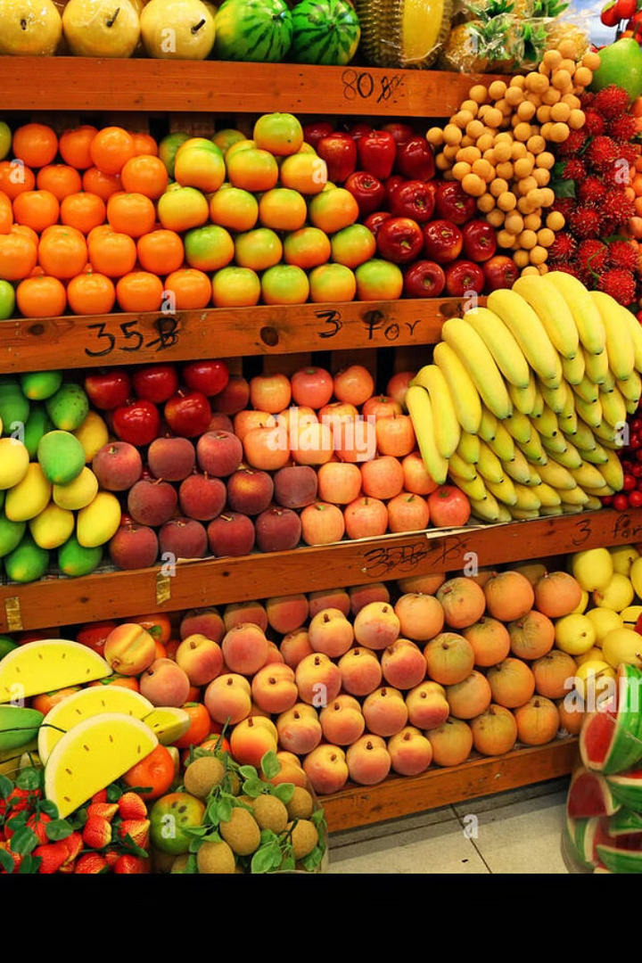
Market Prices
Commodity Pricing
Transportation Costs
Real-time updates on the prices of major agricultural commodities in local and global markets.
Estimates of transportation and logistics expenses to help farmers plan their product sales.
Price Trends
Historical data and analysis to help farmers understand price fluctuations and make informed decisions.

Slide 5

Product Sales
1
Inventory Management
Track and manage your crop yields, enabling you to plan and optimize your sales strategies.
2
Direct-to-Consumer Sales
Connect with local consumers and sell your products directly, maximizing your profits.
3
Supply Chain Integration
Seamlessly integrate your operations with regional and national distribution networks.

Slide 6
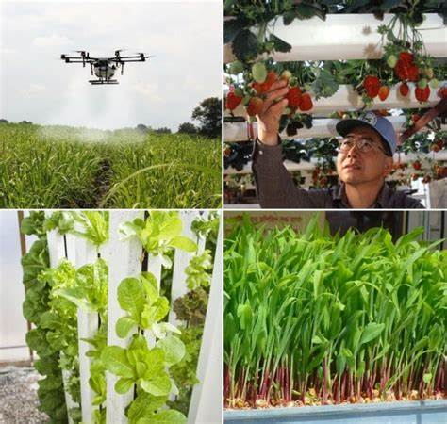
Farming Techniques
Precision Farming
Data-driven approaches to optimize resource allocation, reduce waste, and boost productivity.
Sustainable Practices
Eco-friendly techniques to improve soil health, conserve water, and minimize environmental impact.
Knowledge Sharing
Access to a community of fellow farmers and agricultural experts to learn and collaborate.
Automation and Technology
Leveraging smart farming tools and equipment to streamline operations and enhance efficiency.

Slide 7




Government Schemes
Subsidies and Incentives
Agricultural Policies
Resource Allocation
Insights into the latest government regulations and initiatives aimed at promoting sustainable agriculture.
Guidance on accessing government-funded resources, such as irrigation systems and equipment loans.
Information on available government programs that provide financial support and incentives for farmers.

Slide 8
Weather Forecasts
Temperature
Precipitation
Humidity
Wind Speed
Accurate daily and weekly forecasts to help farmers plan their activities.
Detailed information on expected rainfall and other precipitation to optimize irrigation and planting schedules.
Insights into moisture levels to guide crop selection and pest management strategies.
Wind speed data to inform decisions on pesticide application, greenhouse operations, and other weather-sensitive tasks.

Slide 9

Conclusion and App Features
1
Comprehensive Solution
2
User-Friendly Interface
AgroGuide brings together all the essential information and tools farmers need to optimize their operations and succeed in the modern agricultural landscape.
The app's intuitive design and seamless integration make it easy for farmers of all skill levels to access and utilize the available resources.
3
Continuous Updates
The app is regularly updated with the latest data, research, and industry best practices to ensure farmers always have access to the most relevant information.

Slide 10
Thank you
Group members:
1.Swapnil Supekar
2.Vijay Nirpal
3.Aditya Bhoye
4.Vitthal Shendre

